Slide 1
Topics (Chapter 16)
Define and use structured data types in a C program.
  Access the members of a struct.
  Write functions that take structs as parameters.
  Write functions that return structs.
  Nested Arrays and Structures.
  Program Design.

Slide 2
Declaring Structure Variables
Often need to keep track of several pieces of information about a given thing.
A structure is a logical choice for storing a collection of related data items.
Suppose we need to store information about parts in a warehouse, we can create a structure that collects information about a part.

Slide 3
Defining a Structure Type
A structure tag is a name used to identify a particular kind of structure.
The declaration of a structure tag named part:
struct part {
int number;
char name[NAME_LEN+1];
int on_hand;
};
Note that a semicolon must follow the right brace.
“tag name”

Slide 4
Declaring a Structure Tag
The part tag can be used to declare variables:
struct part part1, part2;
We can’t drop the word struct:
part part1, part2; /*** WRONG ***/
part isn’t a type name; without the word struct, it is meaningless.
Since structure tags aren’t recognized unless preceded by the word struct, they don’t conflict with other names used in a program.
Copyright © 2008 W. W. Norton & Company.
All rights reserved.

Slide 5
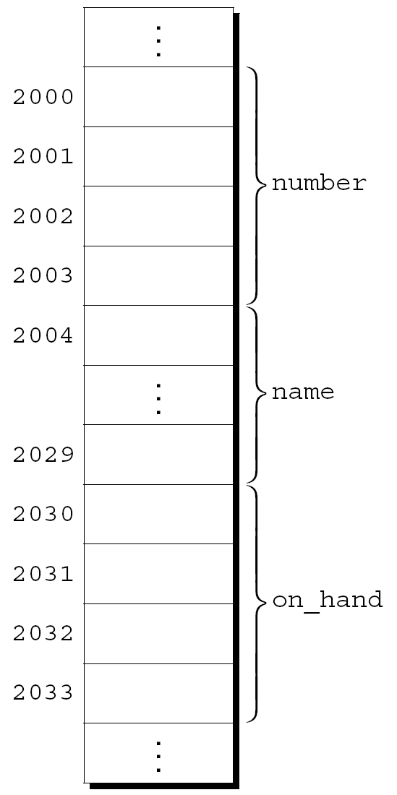
Declaring Structure Variables
The members of a structure are stored in memory in the order in which they’re declared.
Appearance of part1
Assumptions:
  part1 is located at address 2000.
  Integers occupy four bytes.
  NAME_LEN has the value 25.
  There are no gaps between the members.
Copyright © 2008 W. W. Norton & Company.
All rights reserved.

Slide 6
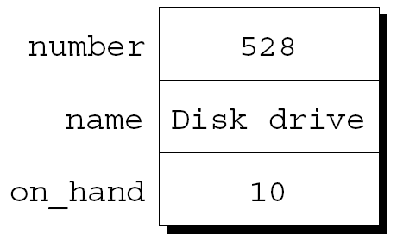
Initializing Structure Variables
A structure declaration may include an initializer:
struct part{
int number;
char name[NAME_LEN+1];
int on_hand;
} part1 = {528, "Disk drive", 10},
part2 = {914, "Printer cable", 5};
Appearance of part1 after initialization:

Slide 7
Initializing Structure Variables
A structure variable can be initialized separately:
struct part{
int number;
char name[NAME_LEN+1];
int on_hand;
};
int main(){
struct part part1 = {528, "Disk drive", 10};
struct part part2 = {914, "Printer cable", 5};
return 0;
}

Slide 8
Exercise
Suppose we wish to store information about colors defined by three pieces of data: red(an int), green (an int), and blue (an int). Each piece is an integer in the range of 0 to 255.
Write a program that declares a struct named color. The declaration includes an initializer for magenta: 255, 0, 255
The main function:
int main(){
  return 0;
  }

Slide 9
Members of a struct
Members of a struct can be any previously defined type
  Including arrays
  Including other structs
  Including pointers

Slide 10
Operations on Structures
To access a member within a structure, we use “.” operator.
We write the name of the structure first, then a period, then the name of the member.
part1.number
part1.name
part1.on_hand
Statements that display the values of part1’s members:
printf("Part number: %d\n", part1.number);
printf("Part name: %s\n", part1.name);
printf("Quantity on hand: %d\n", part1.on_hand);

Slide 11
Exercise
In main function, display the values of megenta’s members using the “.” Operators.

Slide 12
Operations on Structures
The period used to access a structure member is actually a C operator: the dot opeartor
It takes precedence over nearly all other operators.
Example:
scanf("%d", &part1.on_hand);
The . operator takes precedence over the & operator, so & computes the address of part1.on_hand.
Copyright © 2008 W. W. Norton & Company.
All rights reserved.

Slide 13
Exercise
In main function, declare a struct color variable color2.
Read in color2‘s three members using scanf.
Display the values of color2’s members using the “.” Operators.

Slide 14
Operations on Structures
The other major structure operation is assignment:
part2 = part1;
The effect of this statement is to copy part1.number into part2.number, part1.name into part2.name, and so on.
Copyright © 2008 W. W. Norton & Company.
All rights reserved.

Slide 15
Operations on Structures
The = operator can be used only with structures of compatible types.
Structures declared using the same type name are compatible.
Other than assignment, C provides no operations on entire structures.
In particular, the == and != operators can’t be used with structures.

Slide 16
Structures as Arguments and Return Values
Functions may have structures as arguments and return values.
A function with a structure argument:
void print_part(struct part p)
{
printf("Part number: %d\n", p.number);
printf("Part name: %s\n", p.name);
printf("Quantity on hand: %d\n", p.on_hand);
}
A call of print_part:
print_part(part1);
Copyright © 2008 W. W. Norton & Company.
All rights reserved.

Slide 17
Structures as Arguments and Return Values
A function that returns a part structure:
struct part build_part(int number,
char *name,
int on_hand)
{
struct part p;
p.number = number;
strcpy(p.name, name);
p.on_hand = on_hand;
return p;
}
A call of build_part:
part1 = build_part(528, "Disk drive", 10);
Copyright © 2008 W. W. Norton & Company.
All rights reserved.

Slide 18
Structures as Arguments and Return Values
Passing a structure to a function and returning a structure from a function both make a copy of all members in the structure.

Slide 19
Exercise
Add the following functions to the previous program
1.
struct color make_color(int red, int green, int blue);
Returns a color structure containing the specified red, green, and blue values. If any argument is less than zero, the corresponding member will contain zero instead. If any argument is greater than 255, the corresponding member will contain 255.

Slide 20
Exercise
2.
struct color brighter(struct color c);
Returns a color structure that represents a brighter version of the color c: each member has been divided by 0.7. If a member is 0, it is replaced by 3 before the division by 0.7. If dividing by 0.7 causes a member to exceed 255, it is reduced to 255.

Slide 21
Exercise
Test the two functions by adding the following statements in main:
struct color gold = make_color (255, 215, 0);
struct color brighter_gold = brighter (gold);
Then add statements in main to display the values of the members for brighter_gold.

